Slide 1


Loan Data
July 31, 2019
Aracely Motheral
Forest Wolfe
Kent Williams
Ken Murakami

Slide 2
Background
Dataset: Lending Club Data
From 2007 to 2019 of accepted/funded loans
2M+ records
Q1 2019

Slide 3
Hypotheses
Using ML models we can predict how likely a loan applicant is to default

Slide 4
Method
Models:
logistic regression, decision tree, random forest, Kneighbors
Code:
Python, pandas
Infrastructure:
S3, Redshift
Visuals:
Tableau

Slide 5
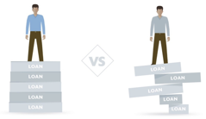
Visualization-Tableau

Slide 6
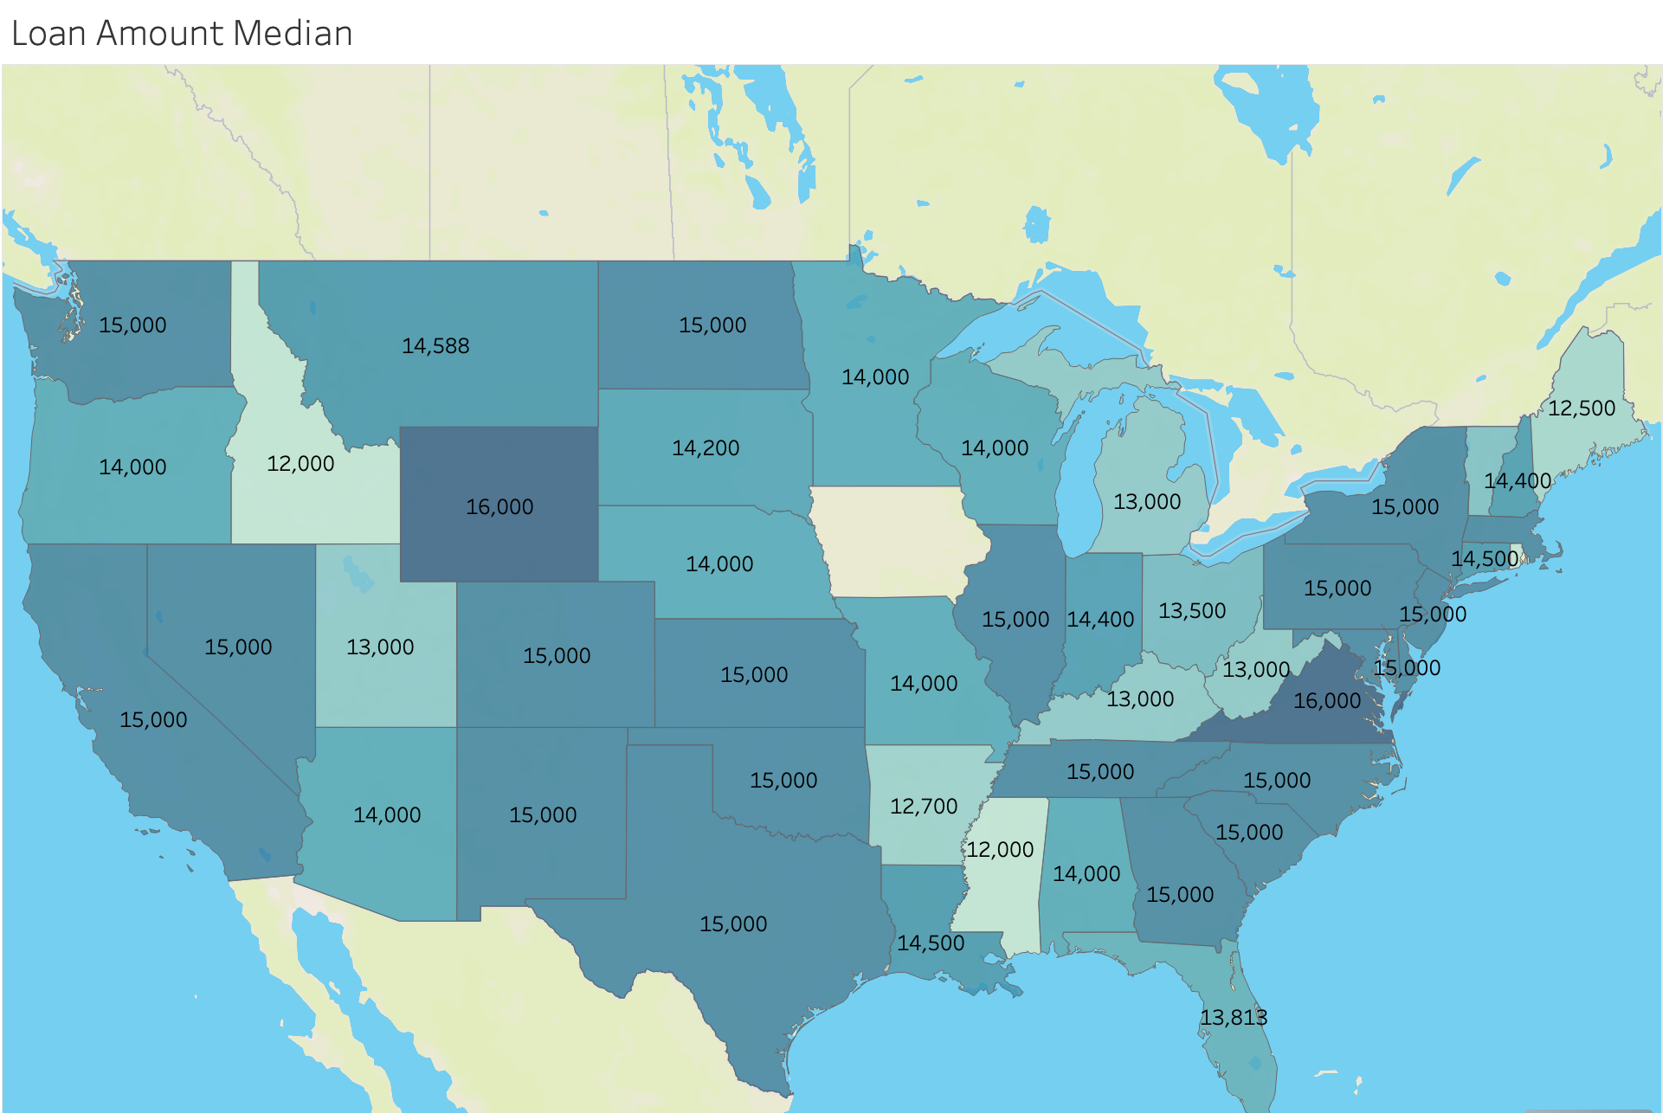
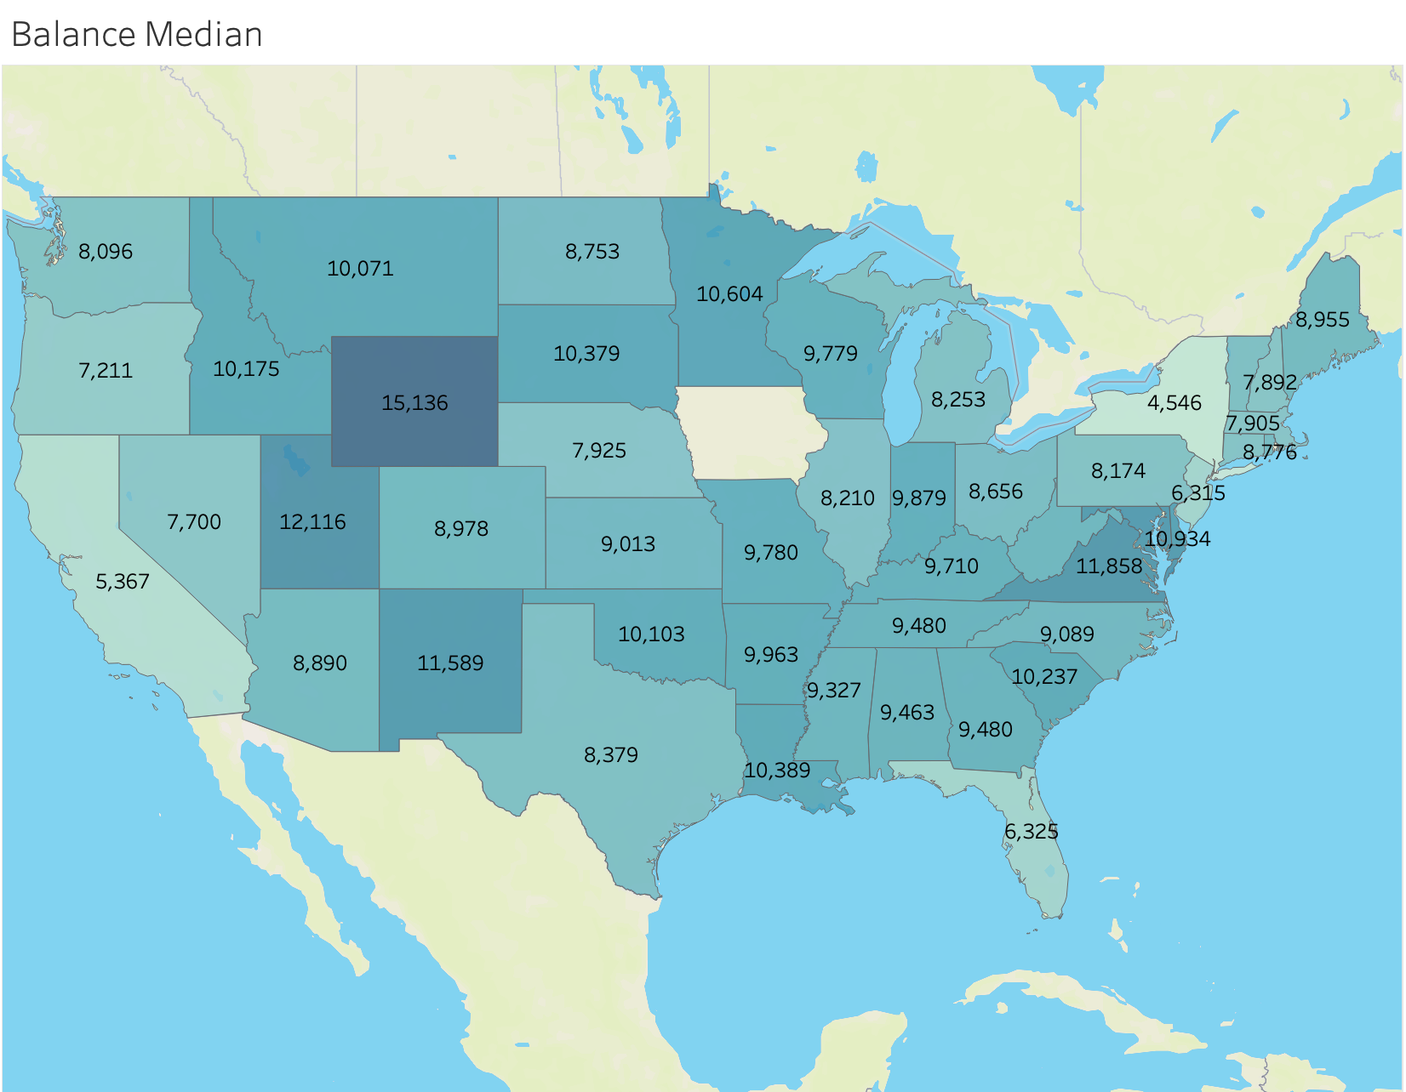
Visualization-Tableau
Loans and Balances

Slide 7
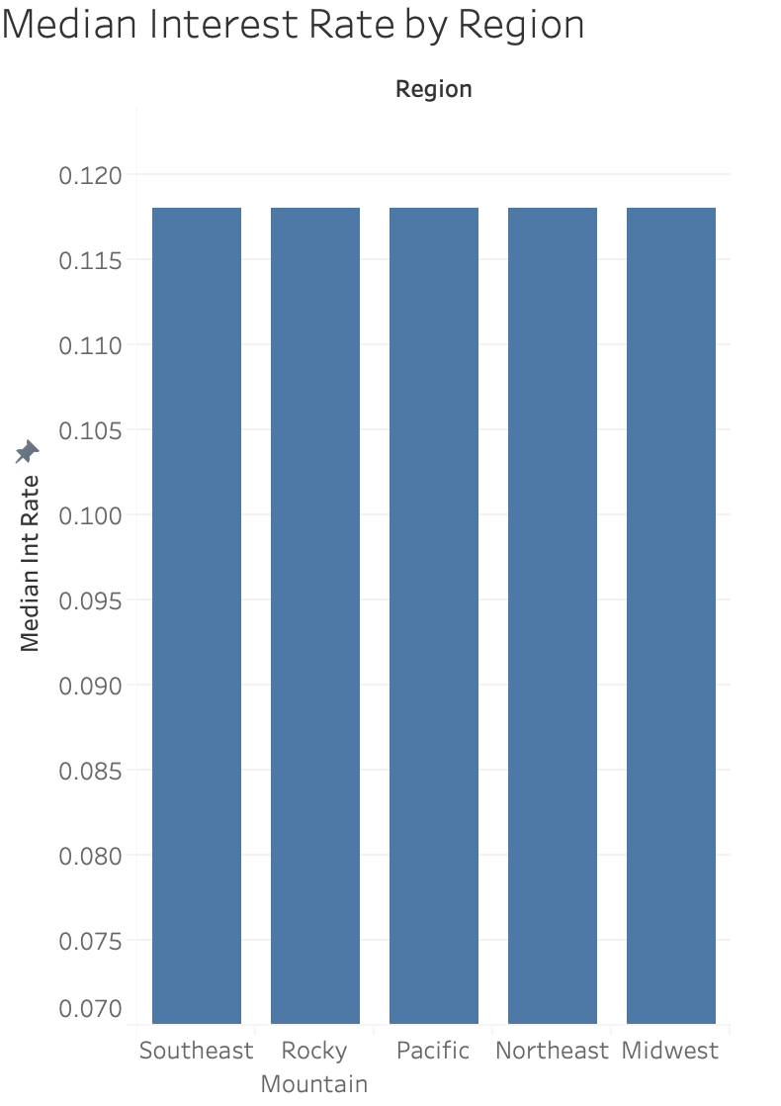
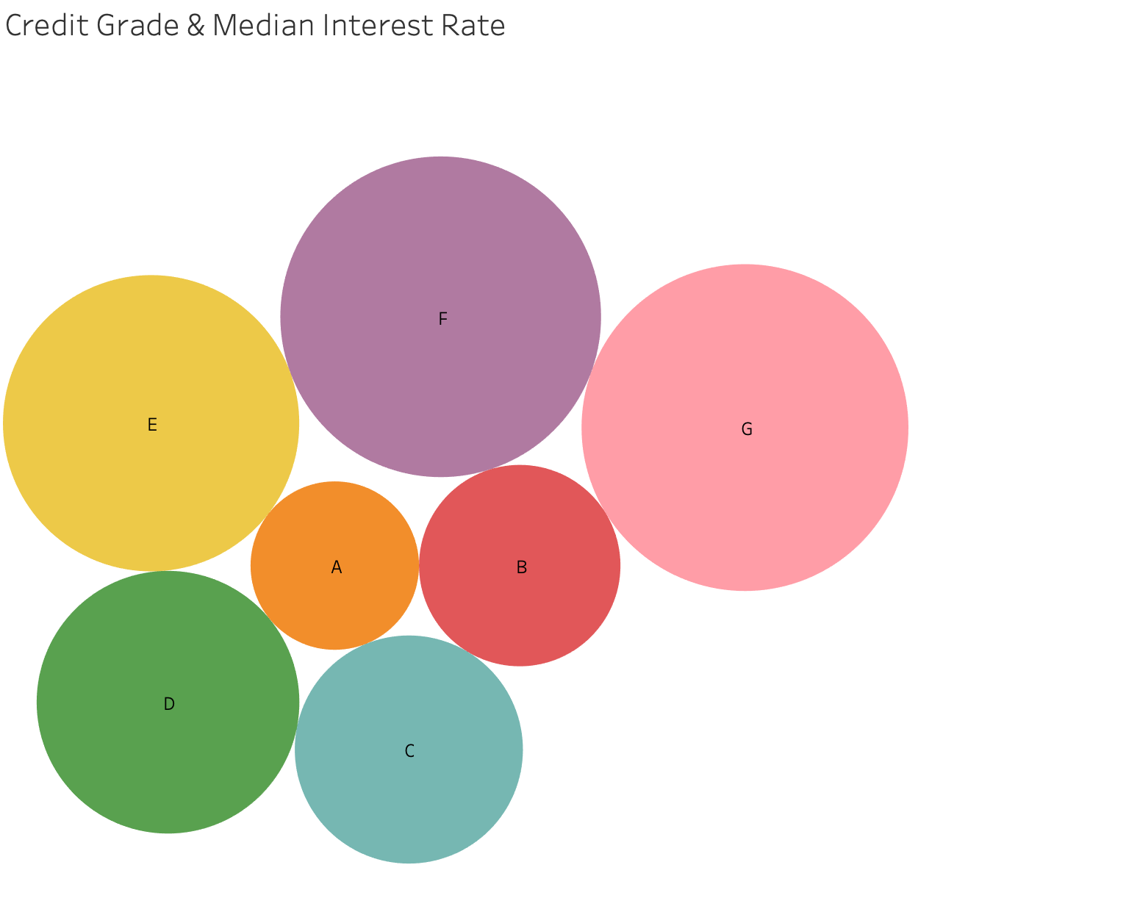
Visualization-Tableau
Rates by Grade and Region

Slide 8
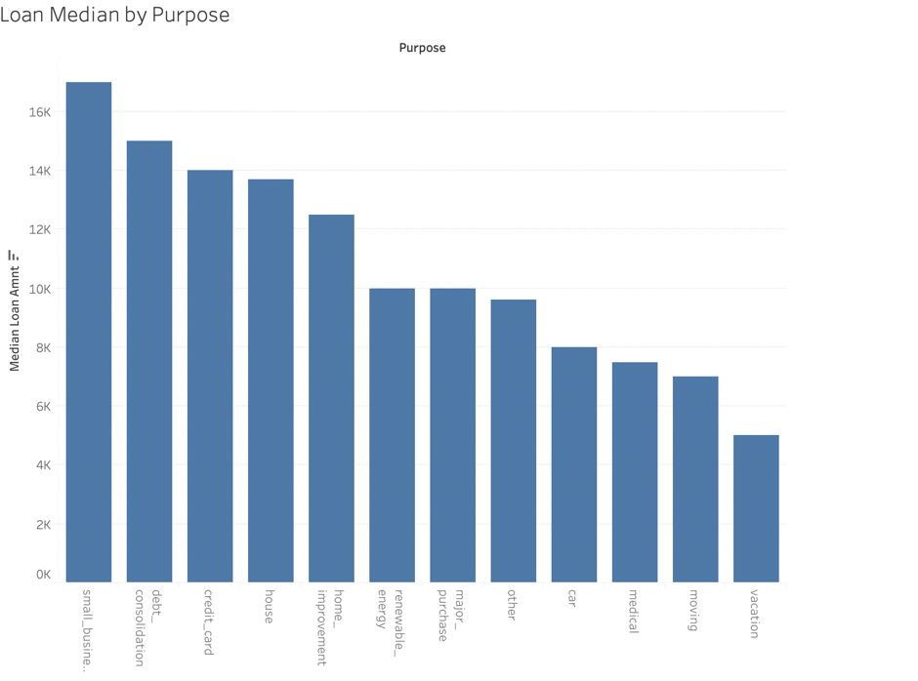
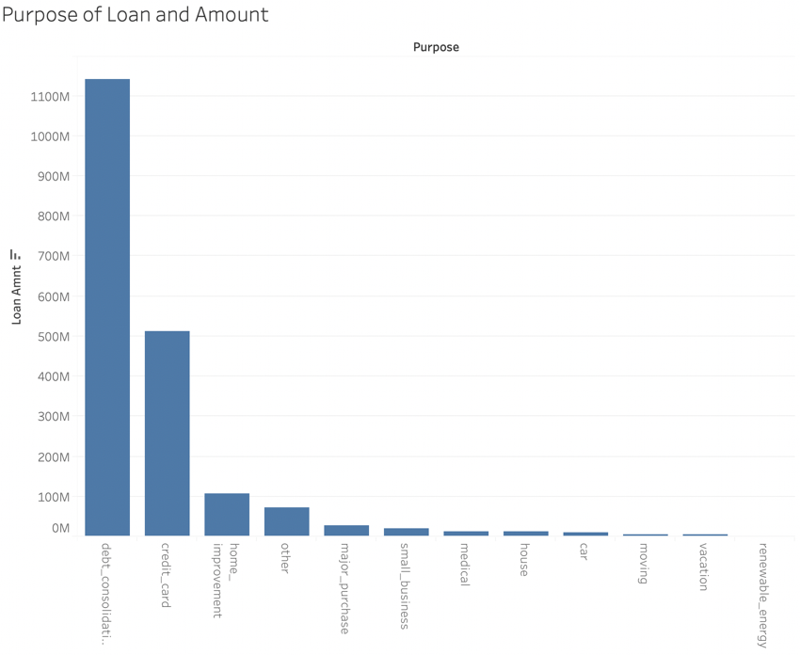
Visualization-Tableau
Purpose of obtaining loan

Slide 9
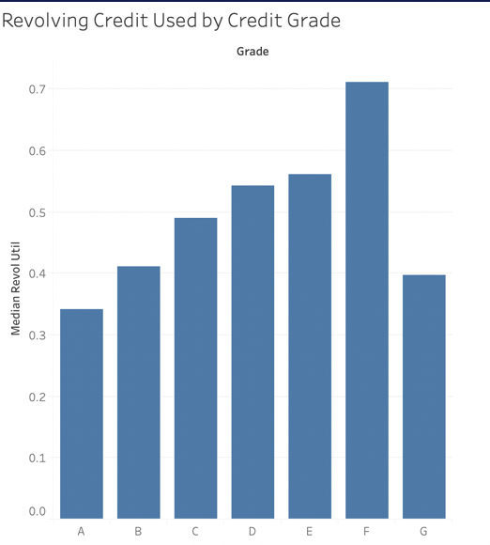
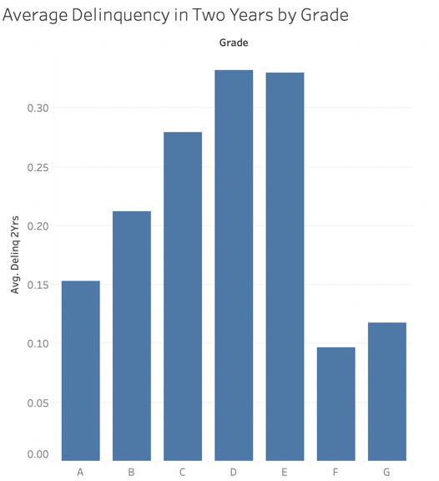
Visualization-Tableau
Credit used and delinquency rates

Slide 10
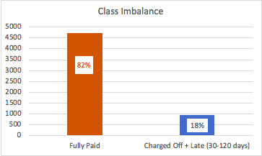
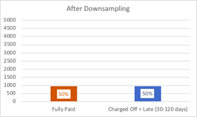
DEALING WITH CLASS IMBALANCE
Class imbalance was skewing the predictions towards the ”Fully Paid” loan status negatively impacting the validity of our models
We used downsampling in order to provide a more even baseline in the training data

Slide 11

MODEL 1: LOGISTIC REGRESSION
Logistic Regressions are good for providing predictions on binary outcomes
Nine different variables were in the analysis
Accuracy: .5711
Misclassification: .4288
Recall: .5425
Specificity: .6008
Precision: .5851
Ran a confusion matrix to assess the predictive strength of our model

Slide 12
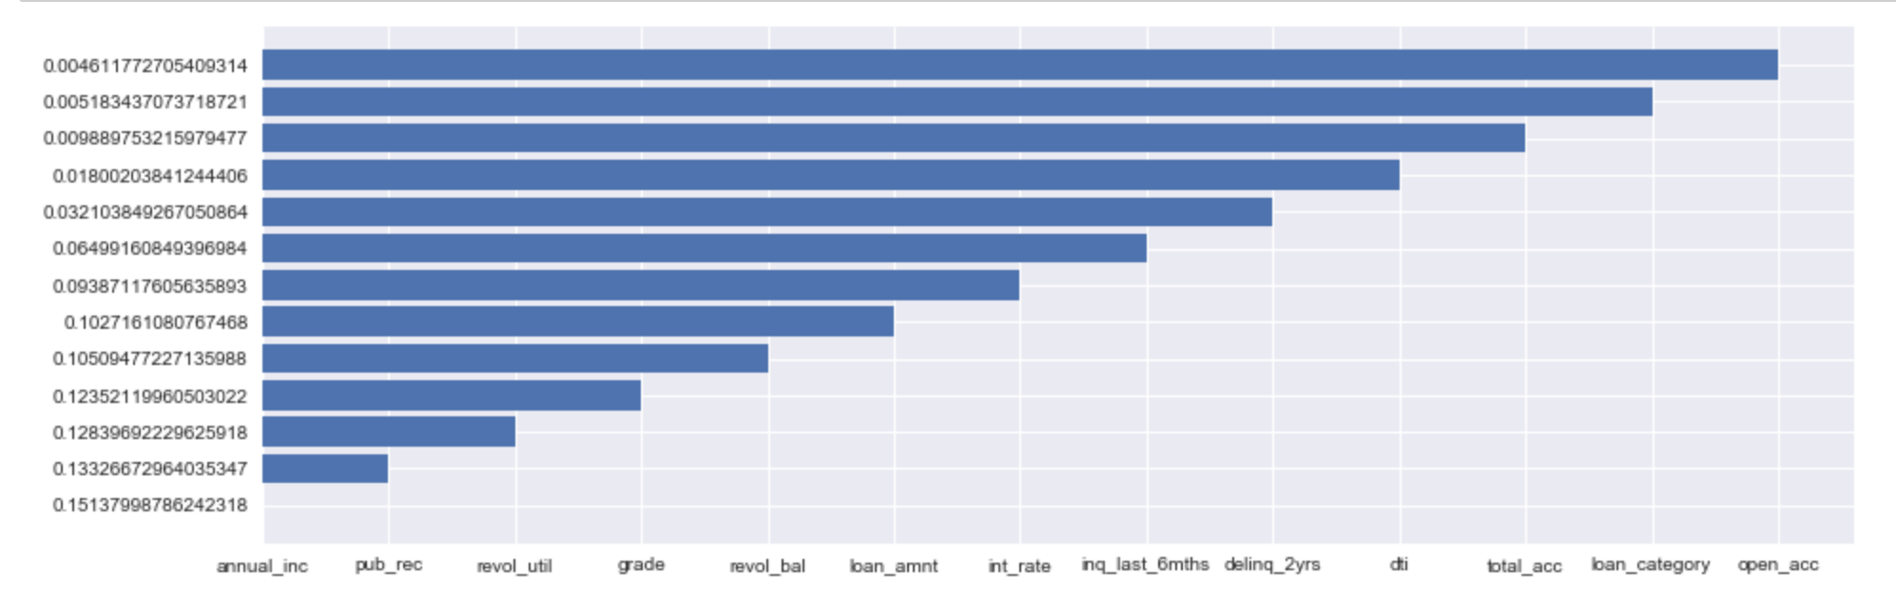
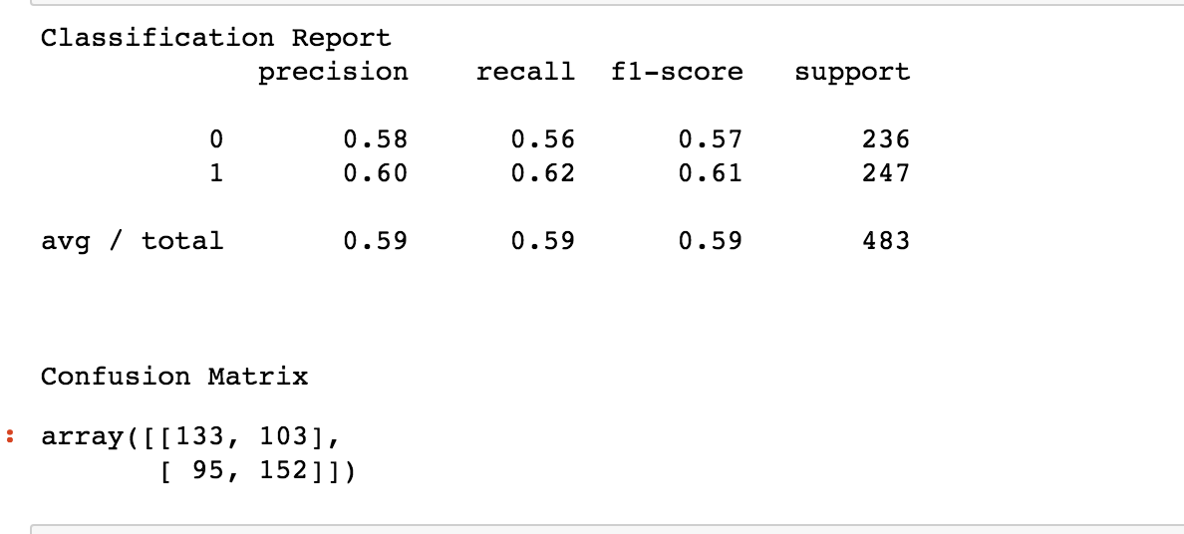
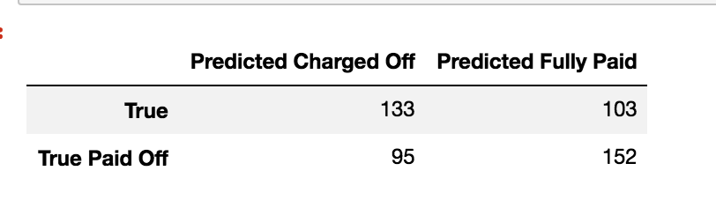
MODEL 2: Decision Tree

Slide 13
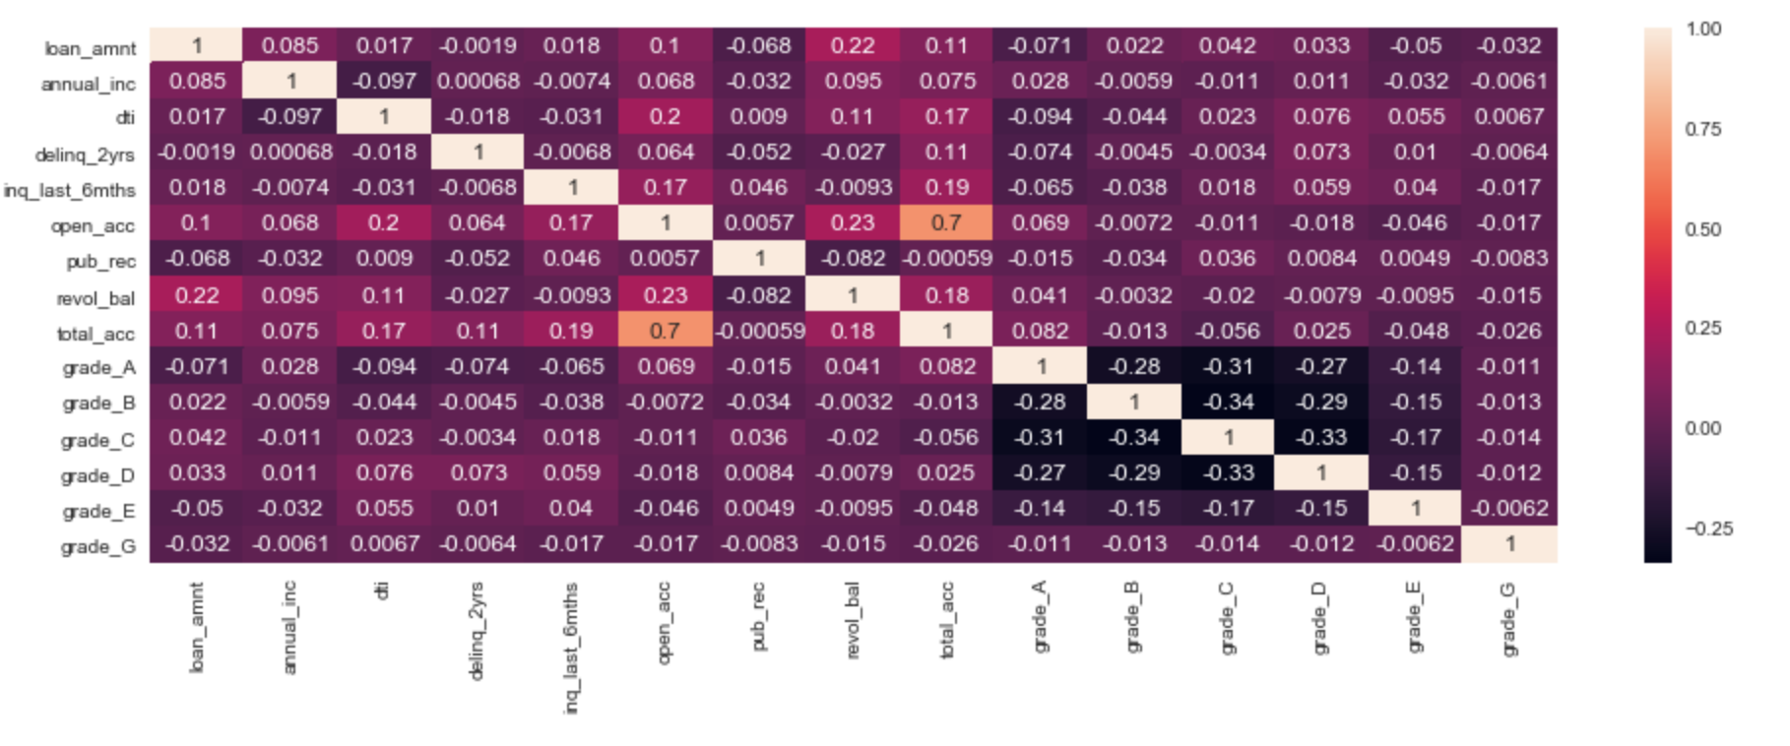
MODEL 2: Decision Tree

Slide 14
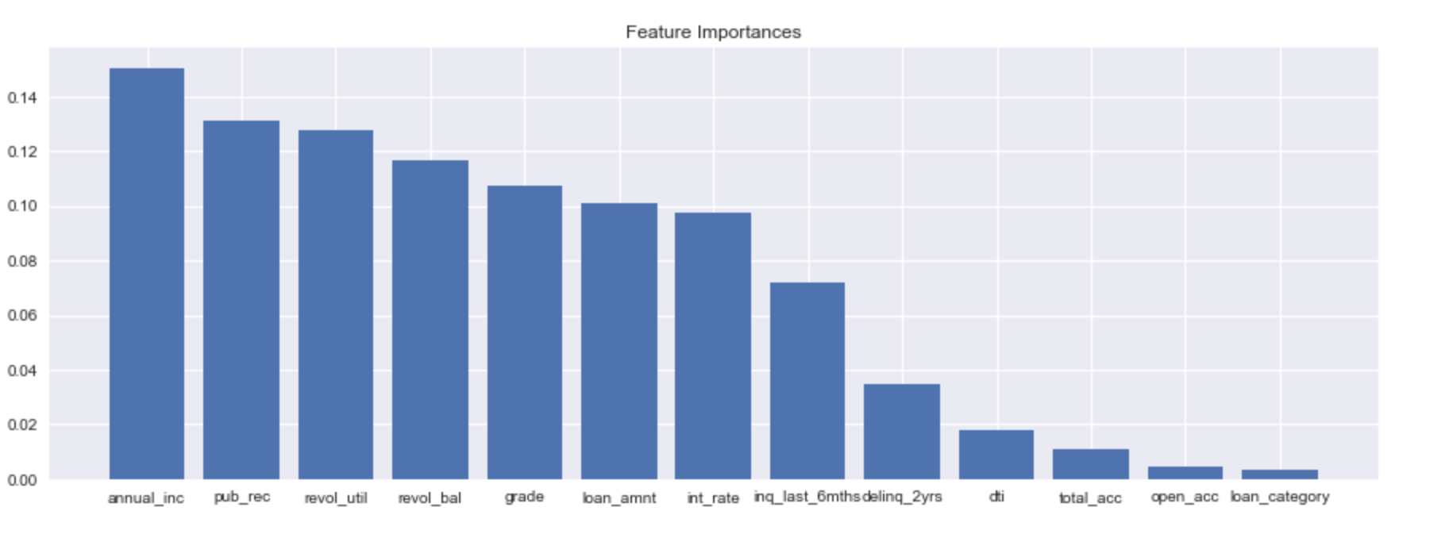
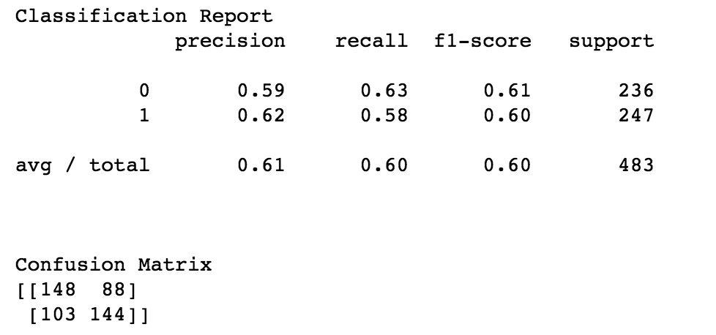
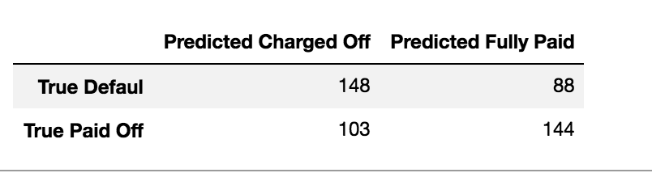
MODEL 3: Random Forest

Slide 15
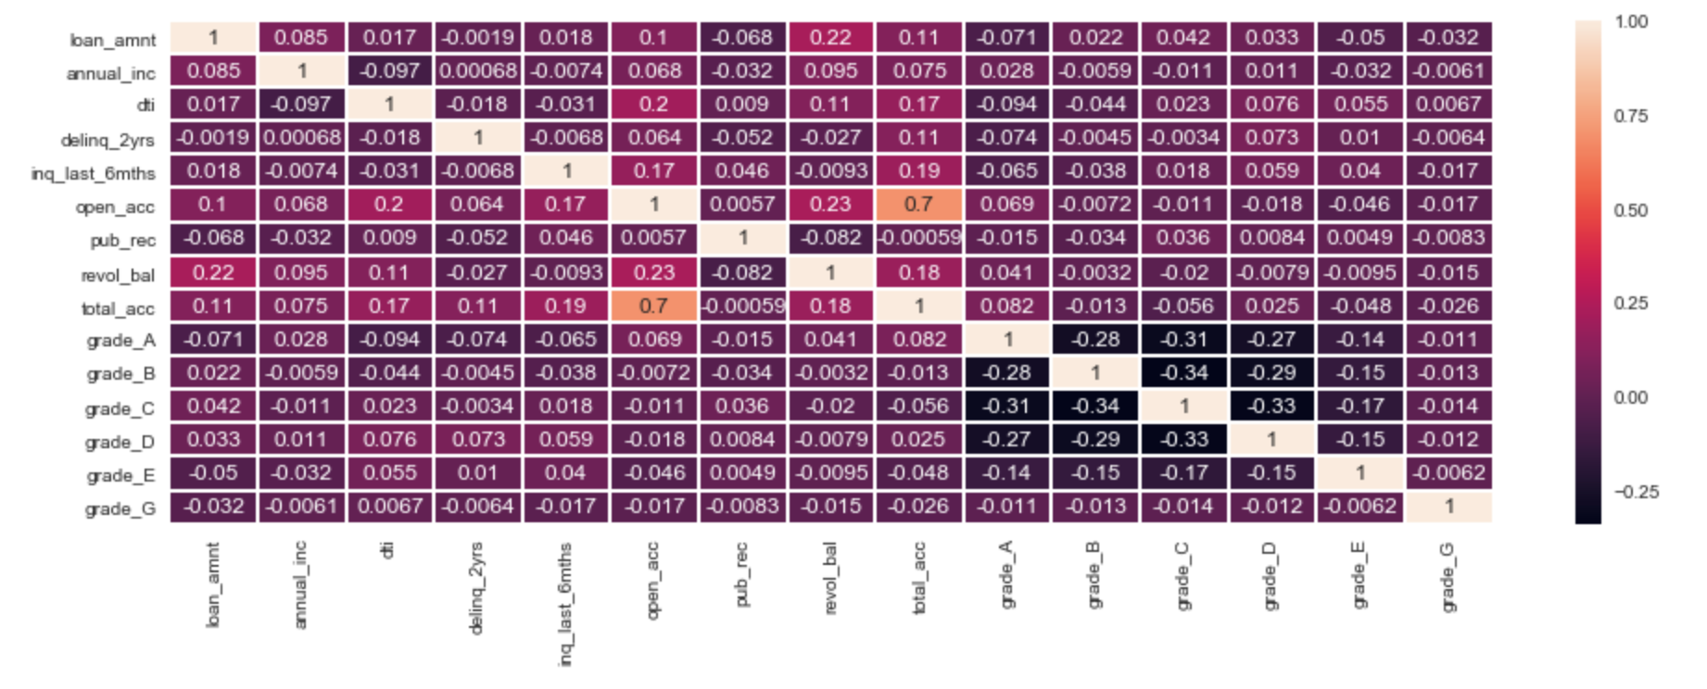
MODEL 3: Random Forest

Slide 16
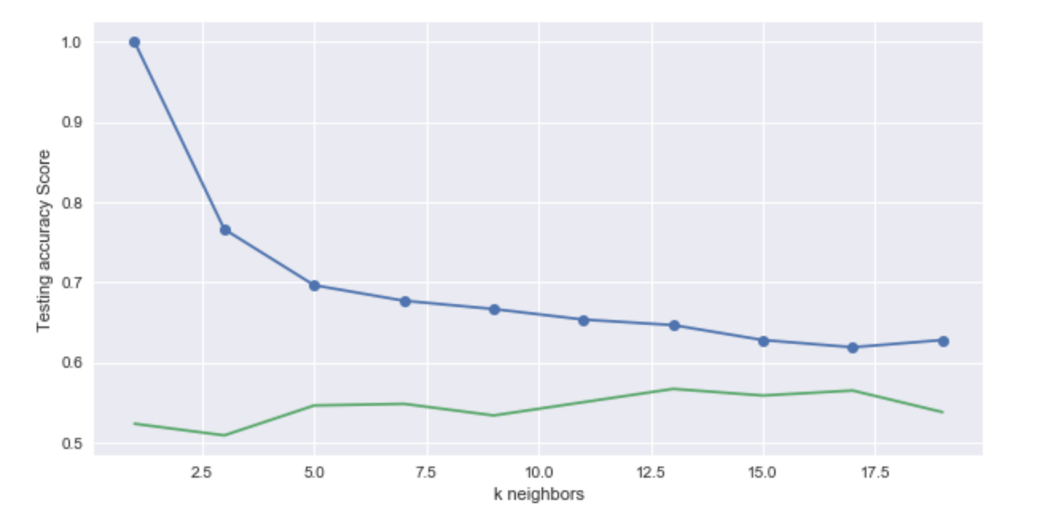
MODEL 4: KNeighbors

Slide 17
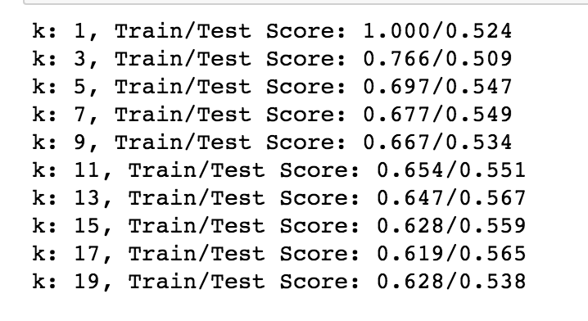
MODEL 4: KNeighbors

Slide 18
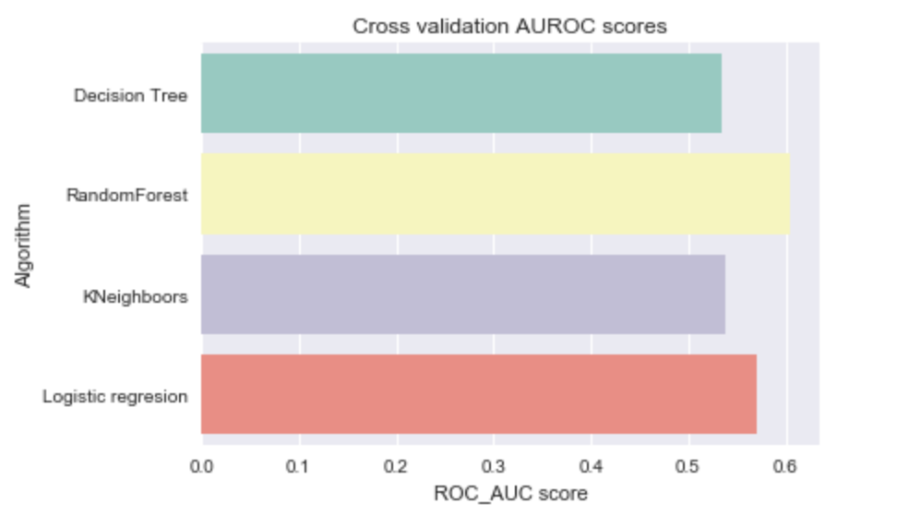
Results

Slide 19
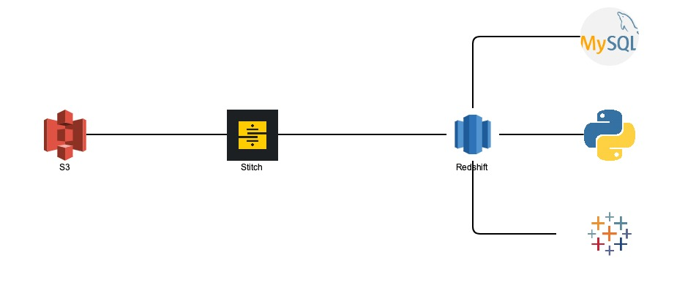
Infrastructure

Slide 20
Problems and Solutions
Finding a dataset
Understanding the data
Omit data
The code
Understanding the models
Building infrastructure

Slide 21
Future Directions
More predictive factors
API’s
Cloud infrastructure
Live data set

